Slide 1
By a help of Akinater
By Basma ,Haidy,Miral and Amira
Girls only group
Leader : Basma

Slide 2

Meeting room for girls team
Miral : background
Haidy: sounds
Amira: sprites
Basma : costumes and helping

Slide 3
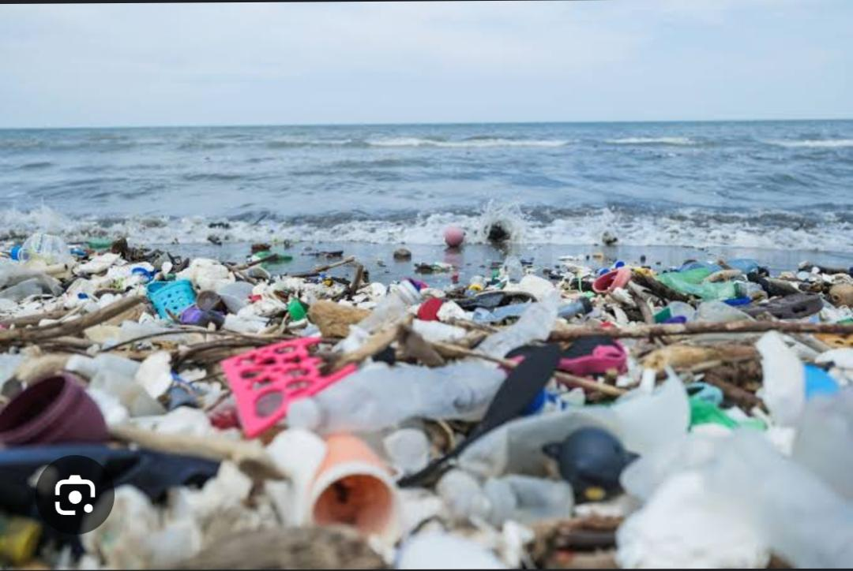
Main story or the event of the story
The ocean was full of dirty thing . The girl saw on her boat the akinater lamp when she rub it the akinater appear and with the 3 wishes the ocean was clean .

Slide 4
THE PROPLEM OF THE STORY
The ocean was dirty and she can,t clean it alone .
SHE NEEDED A HELP OF AKINATER BUT SHE DIDN,T BELIVE AKINATER WAS A REAL GINI

Slide 5
Solution of the story
The akinater by magic clean the ocean and let it cleaner than what it look like before
Akinater appear after ruby the girl rub the akinater lamp

Slide 6
Ending the powerpoint
THANK YOU FOR LOOKING AT THE
POWERPOINT . THANK YOU

